Slide 1
COURSE CODE:
INFT 352
TITLE:
Advanced Web Engineering and Application With PHP
LECTURER/ INSTRUCTOR: P.M SARFO

Slide 2
File Inclusion and Templates

Slide 3
File Inclusion and Templates
In web development, many pages share common elements: headers, navigation bars, footers.
Repeating the same HTML/PHP in each file is inefficient and error-prone.
PHP provides file inclusion to modularize code.
PHP provides two very simple, yet very useful, statements to allow you to reuse code.
Using a require() or include() statement, you can load a file into your PHP script.
The file can contain anything you would normally have in a script including PHP statements, text, HTML tags, PHP functions, or PHP classes.

Slide 4
As you progress in your use of PHP programming, you are likely to start building a library of functions that you think you will need again.
You’ll also probably start using libraries created by other programmers.
There’s no need to copy and paste these functions into your code. You can save them in separate files and use commands to pull them in.

Slide 5
PHP include and require Statements
The include and require statements are identical, except upon failure:
Require will produce a fatal error (E_COMPILE_ERROR) and stop the script
Include will only produce a warning (E_WARNING) and the script will continue

Slide 6
If you want the execution to go on and show users the output, even if the include file is missing, use the include statement.
Always use the require statement to include a key file to the flow of execution.
This will help avoid compromising your application's security and integrity, just in-case one key file is accidentally missing.

Slide 7
The include Statement
Using include, you can tell PHP to fetch a particular file and load all its contents.
It’s as if you pasted the included file into the current file at the insertion point.

Slide 8
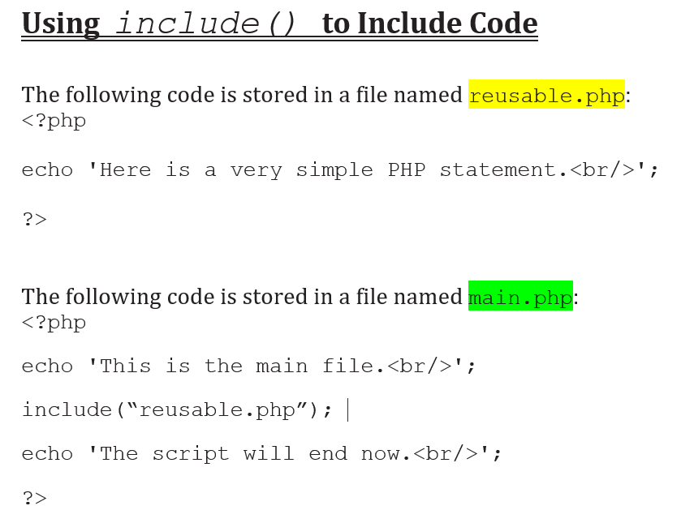

Slide 9
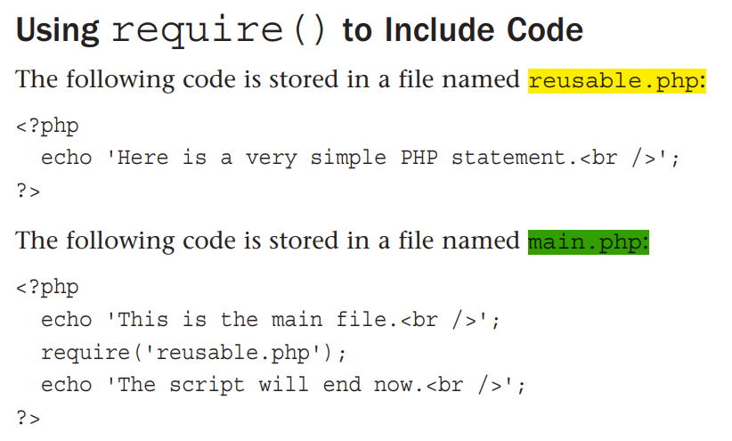

Slide 10
The Advantages of Include/Require (Reusing Code ).
One of the goals of software engineers is to reuse code in lieu of writing new code.
The reason for this is not that software engineers are a particularly lazy group, but instead because reusing existing code
reduces costs,
increases reliability, and
improves consistency.
Ideally, a new project is created by combining existing reusable components, with a minimum of development from scratch.

Slide 11
Modular Page Design
Modular Page Design is a web development and design approach that involves breaking a webpage into reusable, independent components (or modules), which can be developed, updated, and maintained separately.
These modules can be headers, footers, navigation bars, content sections, or widgets — all functioning like building blocks to create complete web pages.

Slide 12
Key Concepts of Modular Page Design:
Reusability: Common parts like headers, footers, sidebars, and menus are written once and reused across multiple pages.
Separation of Concerns: HTML, CSS, JavaScript, and server-side scripts (like PHP includes) are often separated to make the code cleaner and more maintainable.
Maintainability: Updates made to one module automatically reflect on all pages that use it, making site-wide updates easier.
Scalability: As the website grows, new modules can be added without rewriting existing code.
Consistency: Ensures a uniform look and feel across all pages of a site.

Slide 13
Examples of Modules:
Header
Navigation bar
Sidebar
Main content section
Footer
Login form
Newsletter signup
Product card

Slide 14
Benefits of Modular Page Design:
Faster development
Easier debugging
Better team collaboration
Cleaner codebase
Easier to test individual parts

Slide 15
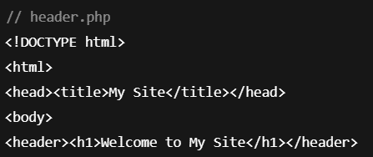
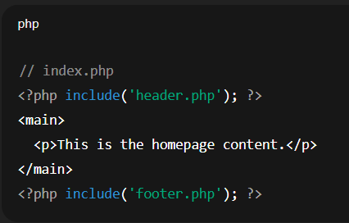
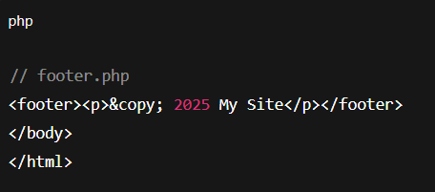

Slide 16
Using Functions in PHP

Slide 17
A function is a block of statements that can be used repeatedly in a program.
A function will not execute immediately when a page loads.
A function will be executed by a call to the function.
They allow you to execute a block of code arbitrarily throughout your script.
You declare a block of code as a function and then you are able to call the function anywhere.
When calling a function, you pass any number of arguments, and the function, returns a value.

Slide 18
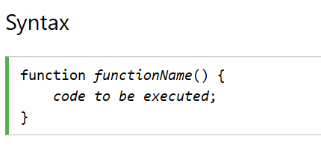
Declaring a Function
When you declare a function, you start with the function statement.
Next comes a name for your function.
Inside the parentheses is a list of arguments separated by commas. You may choose to have no arguments.

Slide 19
THANK YOU
Program - level
Name - index number
19

